Slide 1
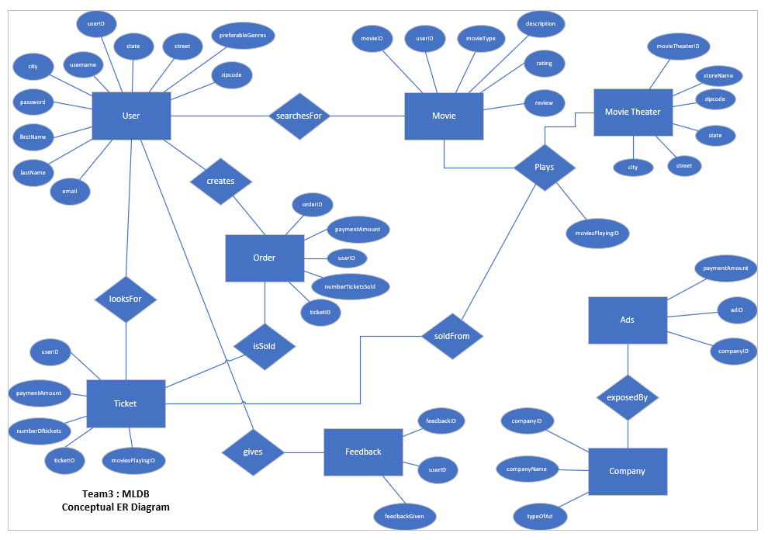

Slide 2
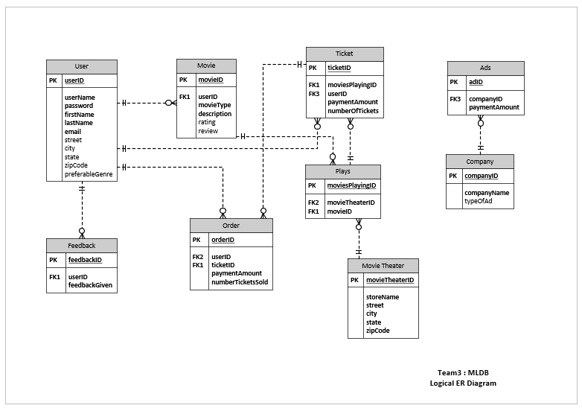

Slide 3
Revision Notes:
User entity
- Removed the following attributes: userType, phone, createdTS and updatedTS
2) Ticket entity
- Removed the following attributes: createdTS, movieID and movieTheatherID
- Created the attribute moviesPlayingID and the relationship soldFrom to Plays entity
3) Order entity
- Removed the attribute createdTS
4) Movie Theater entity
- Removed the following attributes: createdTS, userID, longitude, lagitude, startDate
- Removed the relationships soldFrom from Ticket entity and receives from Feedback entity
5) Feedback entity
- Removed the relationship receives from Movie Theater
- Removed the following attributes: movieTheaterID and createdTS
6) Movie entity
- Removed the following attributes: favoritedMovie and createdTS
7) Plays entity
- Created the relationship soldFrom to Ticket entity
8) Ads entity
- Included Ads entity to handle the ads that the app will display
9) Company entity
- Included Company entity to store the information about the partner that will display the advertisement
10) ExposedBy relationship
- Included the exposedBy relationship between Ads and Company

